Slide 1

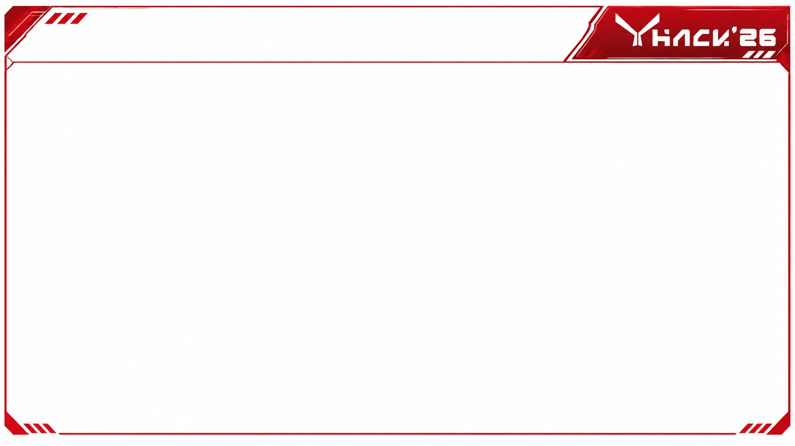







TITLE: CNN-Based Automated Industrial Surface Defect Detection and Classification
TEAM NAME: PRIVISA
TEAM ID: YS518
PS ID: 6
DOMAIN: Manufacturing/Industrial quality control
TEAM LEADER NAME: Priyashilini R
MEMBER-1 NAME: Prajin sharom kumar L
MEMBER-2 NAME: Vignesh kumaran T S
MEMBER-3 NAME: Satheesh kumar S
MEMBER-4 NAME: Vijaya varshin P

Slide 2

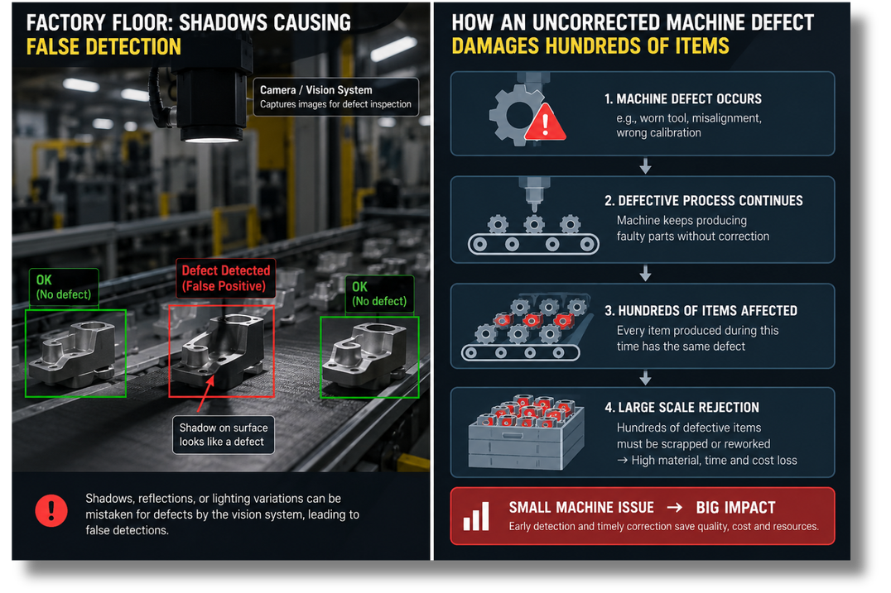
PROBLEM STATEMENT
The Core Problem: High-speed manufacturing lines face high rejection rates due to missed surface defects and delayed machinery maintenance.
Key Industrial Bottlenecks:
Environmental Instability: Factory floor lighting shifts, shadows, and reflections break traditional computer vision rules.
Inspector Fatigue: Human operators miss subtle micro-cracks and surface scratches over long shifts.
Non-Actionable Detection: Standard AI flags that a part is broken, but leaves engineers guessing why it broke, causing hours of line downtime.

Slide 3
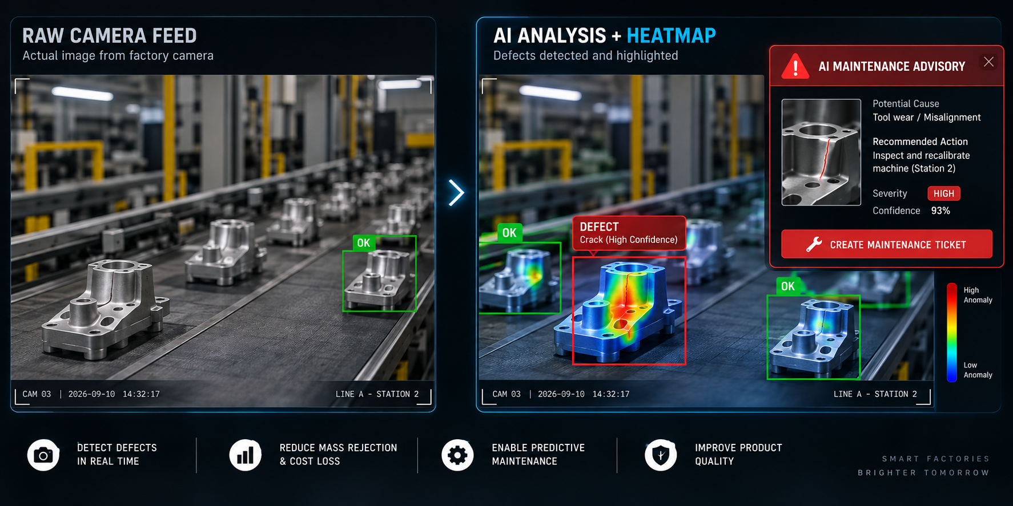
PROPOSED SOLUTION
"Existing systems tell you THAT a part is broken. EdgeDefect AI tells you WHY it broke and HOW to fix the machine."
Solution Overview: An integrated pipeline combining fast edge detection with generative AI diagnostics.
Key Solution Pillars:
Lighting Auto-Fix: OpenCV pre-processing stabilizes brightness and contrast variations across shift changes.
Sub-50ms Detection: Quantized YOLOv8 engine localizes and classifies defect types (Scratches, Cracks, Dents, Discoloration).
Automated RCA Engine: Open-source AI translates defect spatial patterns into actionable maintenance advisories.

Slide 4
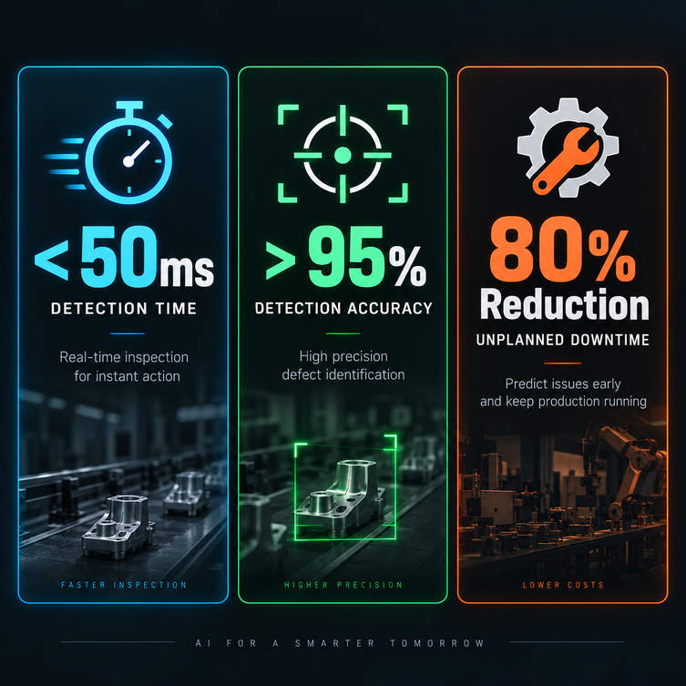
OBJECTIVE
Primary System Objectives:
Automate end-to-end defect detection across variable surface materials.
Eliminate false positives caused by ambient lighting and glare.
Deliver instant root-cause maintenance advisories directly to maintenance technicians.
Key Success Metrics:
Inference Speed: <50ms processing latency per image.
Detection Accuracy: >95% recall across industrial surface defect benchmarks.
Downtime Reduction: Up to 80% reduction in machinery diagnostic delay.

Slide 5
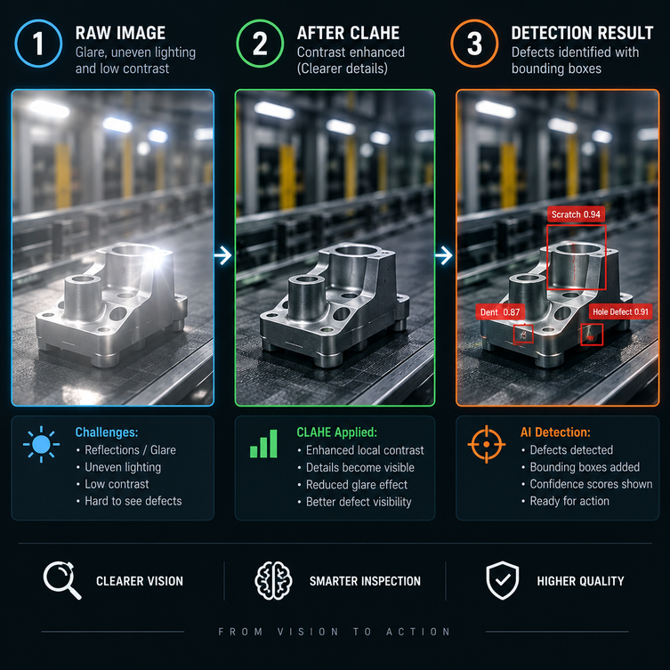
METHODOLOGY
Adaptive Lighting Pipeline:
Step 1 (Ingestion): Receive raw camera feed from the conveyor belt.
Step 2 (Normalization): Apply Contrast Limited Adaptive Histogram Equalization (CLAHE) to neutralize glare and harsh shadows.
Step 3 (Edge Alignment): Automated contour extraction to correct component rotation before AI inference.
Dataset & Transfer Learning:
Fine-tuned pre-trained vision models using benchmark industrial surface defect datasets (NEU / DAGM).
Synthetic data augmentation (geometric shifts, brightness variations) for high real-world accuracy.

Slide 6
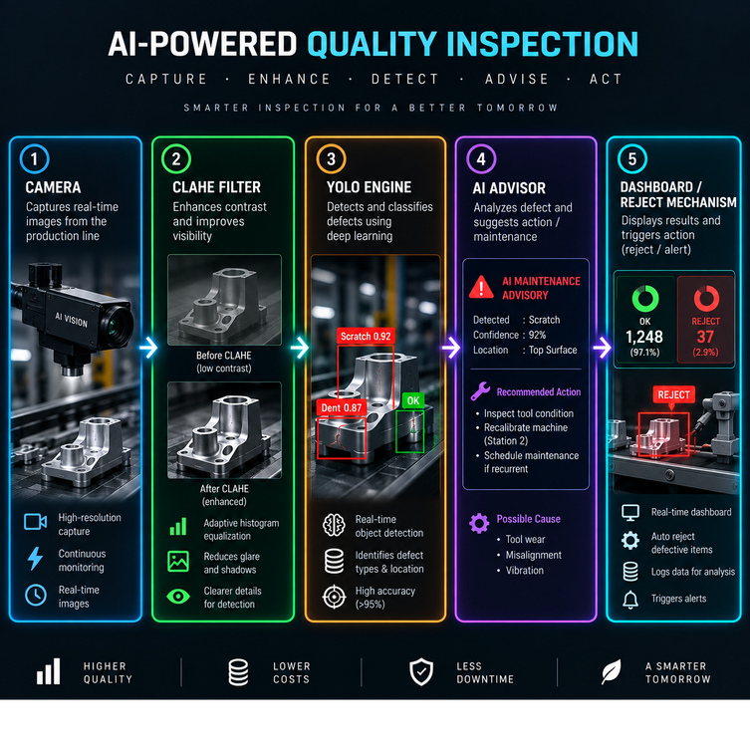
WORKFLOW
End-to-End System Execution Flow:
Image Capture: Conveyor camera snaps part photo -> sends to Python FastAPI backend.
Pre-Processing: Image normalized via CLAHE -> passed to quantized YOLOv8 model.
Detection & Masking: Bounding box generated, confidence score computed, defect categorized.
Root-Cause Analysis: Spatial coordinates sent to Open-Source AI API to generate machine repair steps.
Actionable Output: PASS items continue on conveyor; FAIL items trigger pneumatic reject arm and update maintenance dashboard.

Slide 7
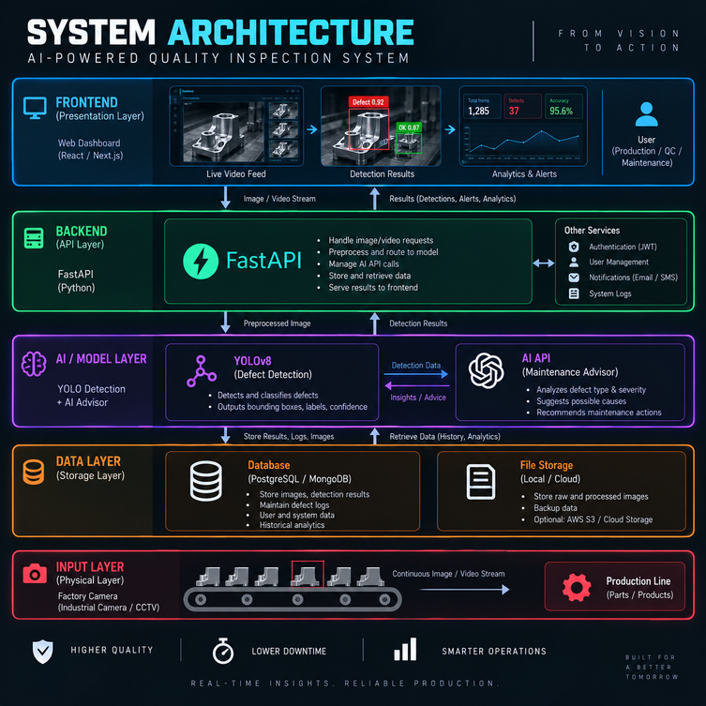
SYSTEM ARCHITECTURE
Modular Architecture Layers:
Frontend UI: React / Next.js + Tailwind CSS for real-time live video and quality metrics.
Backend Gateway: Python FastAPI for asynchronous API handling and image processing.
Vision Core: OpenCV + YOLOv8 (PyTorch / ONNX Runtime) for ultra-fast inference.
Generative Reasoning Engine: Open-Source AI Endpoint (via Antigravity / HuggingFace) for root-cause generation.
Data Storage: SQLite / JSON logs for shift analytics and ISO audit compliance.

Slide 8
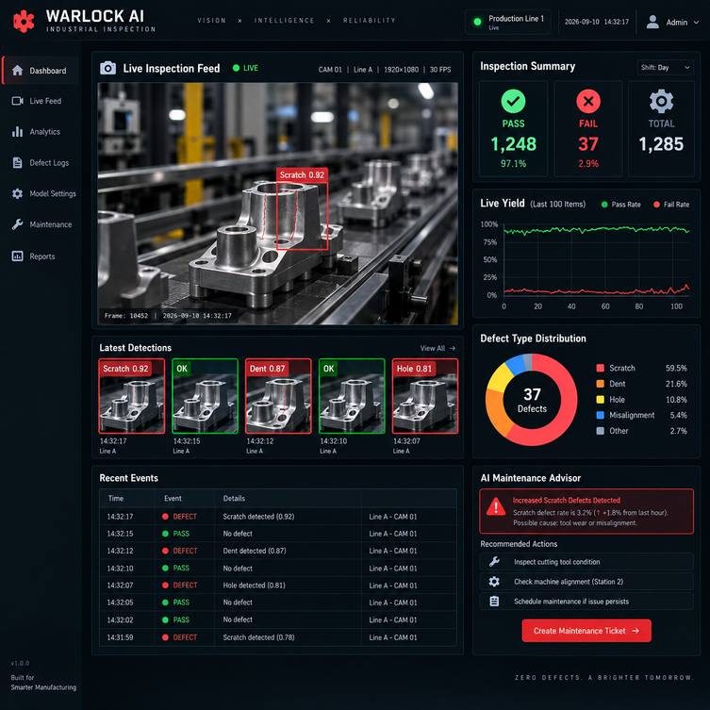
IMPLEMENTATION
Operator Dashboard Capabilities:
Live Stream Feed: Displays bounding boxes, classification labels, and confidence percentages in real time.
Lighting Correction Toggle: Allows QA inspectors to compare raw camera input against normalized pre-processed frames.
Real-Time Analytics: Pie charts tracking defect distribution (Scratches vs. Cracks) and yield rate percentages.
Confidence-Gated Safety Queue: Automatically routes borderline predictions (50% - 80% confidence) to a human manual review queue.

Slide 9
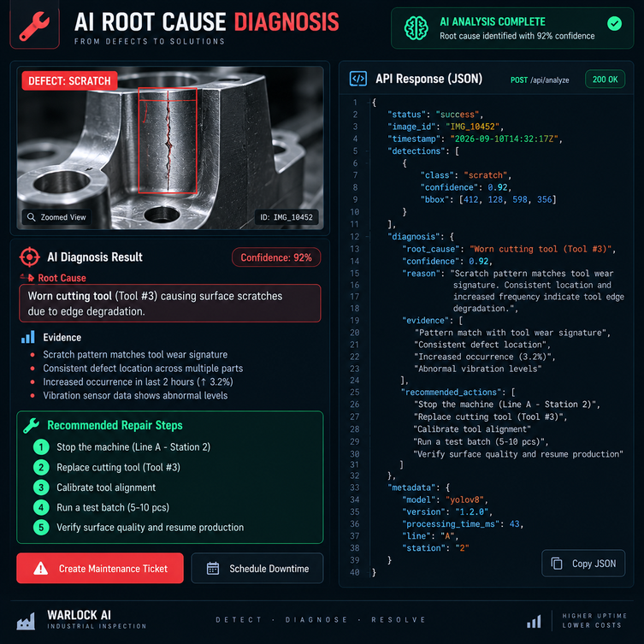
IMPLEMENTATION
Translating Patterns into Maintenance Action:
Pattern Analysis: Spatial coordinates translate visual flaws into mechanical insights (e.g., repeating linear scratch vs. single point dent).
Automated Repair Advisory: System generates precise instructions:
"Linear scratch pattern detected at 5cm intervals -> Cause: Conveyor Belt Roller #2 is stuck and dragging on metal sheets -> Action: Inspect and lubricate Roller #2."
Real-Time Optimization:
Sub-50ms core vision detection keeps the assembly line moving without delay.
Generative AI reports compile asynchronously in the background.

Slide 10



